Slide 1


SIMATS ENGINEERING
SAVEETHA INSTITUTE OF MEDICAL AND TECHNICAL SCIENCES
Fundamental Python Libraries for Data Scientists
NumPy • SciPy • Scikit-learn • Pandas • Matplotlib • IDEs
DSA0404– Fundamentals of Data Science
Date :07/8/2026
Guided by:
Dr. Krishnaraj Mony
Presented by:
Sk. Nuha-192472242

Slide 2



Introduction to Python in Data Science
Python: The Foundation of Data Science
Python is one of the most popular programming languages for Data Science.
It offers a simple syntax, making it easy to learn and implement.
Python provides powerful libraries for data analysis, visualization, and machine learning.
It supports handling large datasets efficiently with optimized performance.
Python is open-source, cross-platform, and supported by a large developer community.
Industries such as healthcare, finance, education, and e-commerce extensively use Python for data-driven decision-making.

Slide 3

NumPy – Numerical Computing Library
NumPy (Numerical Python)
NumPy is the fundamental library for numerical and scientific computing in Python.
It introduces the ndarray, a fast and memory-efficient multidimensional array.
Supports vectorized operations that are significantly faster than traditional Python lists.
Provides built-in mathematical, statistical, and linear algebra functions.
Includes random number generation and matrix manipulation capabilities.
Forms the foundation for many other Data Science libraries such as Pandas, SciPy, and Scikit-learn.

Slide 4

SciPy – Scientific Computing Library
SciPy (Scientific Python)
SciPy extends NumPy by providing advanced scientific and mathematical functions.
It includes modules for optimization, integration, interpolation, and statistics.
Supports signal processing and image processing applications.
Offers powerful linear algebra and matrix decomposition techniques.
Widely used in engineering, research, physics, and scientific simulations.
Enables efficient implementation of complex mathematical models with minimal code.

Slide 5

Pandas – Data Analysis Library
Pandas
Pandas is a powerful library designed for data manipulation and analysis.
It introduces Series (1D) and DataFrame (2D) data structures.
Supports importing and exporting data from CSV, Excel, SQL, and JSON files.
Provides efficient data cleaning, filtering, sorting, and aggregation functions.
Handles missing values and duplicate records effectively.
Commonly used for exploratory data analysis before building machine learning models.

Slide 6
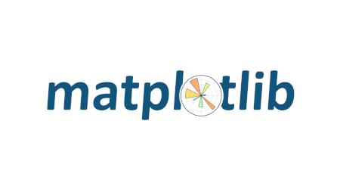
Matplotlib – Data Visualization Library
Matplotlib
Matplotlib is a comprehensive library for creating static and interactive visualizations.
Supports various chart types including line, bar, pie, scatter, histogram, and box plots.
Helps identify trends, relationships, and patterns within datasets.
Offers extensive customization options for colors, labels, titles, and legends.
Integrates seamlessly with NumPy and Pandas for plotting data.
Widely used in research, business reporting, and dashboard development.

Slide 7

Scikit-learn – Machine Learning Library
Scikit-learn
Scikit-learn is a widely used Python library for machine learning applications.
Provides algorithms for classification, regression, clustering, and dimensionality reduction.
Includes tools for data preprocessing, feature selection, and model evaluation.
Supports supervised and unsupervised learning techniques.
Built on top of NumPy, SciPy, and Matplotlib for efficient performance.
Used in predictive analytics, recommendation systems, fraud detection, and AI applications.

Slide 8
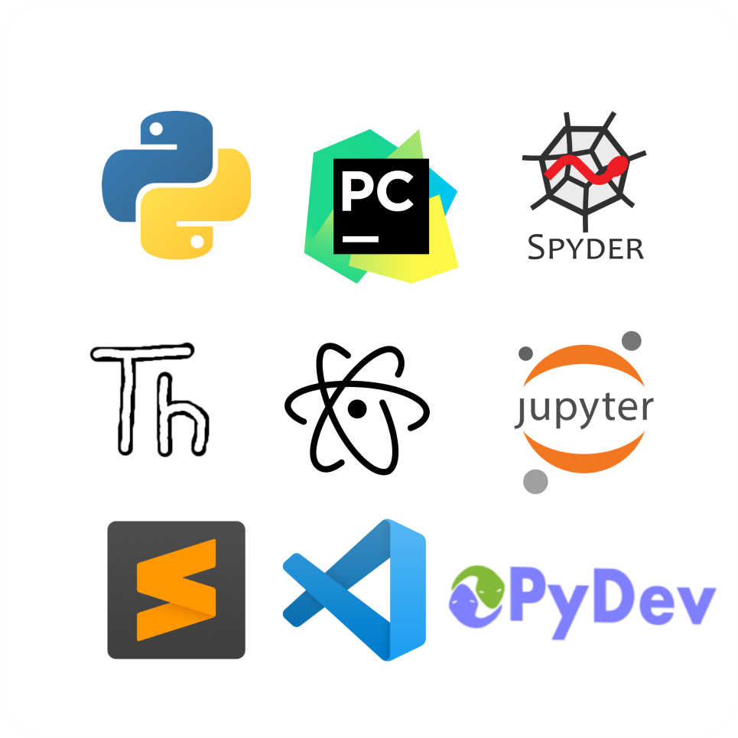
Python IDEs for Data Science
Integrated Development Environments (IDEs)
IDEs provide a complete environment for writing, executing, and debugging Python programs.
Jupyter Notebook is ideal for interactive coding and data visualization.
PyCharm offers advanced debugging, code completion, and project management features.
Visual Studio Code provides lightweight development with powerful extensions.
Spyder is designed specifically for scientific computing and data analysis.
Google Colab enables cloud-based programming with free GPU and collaborative features.

Slide 9
Comparison of Fundamental Python Libraries
Library | Primary Purpose | Major Applications
NumPy | Numerical Computing | Arrays, Matrix Operations
SciPy | Scientific Computing | Statistics, Optimization
Pandas | Data Analysis | Data Cleaning & Processing
Matplotlib | Visualization | Graphs and Charts
Scikit-learn | Machine Learning | Prediction & Classification
Python IDEs | Development | Coding, Debugging & Testing

Slide 10

Applications and Advantages
Applications and Benefits
Used in healthcare for disease prediction and medical data analysis.
Applied in finance for stock market forecasting and risk analysis.
Enables customer behavior analysis in e-commerce and business intelligence.
Supports research through statistical analysis and scientific simulations.
Reduces development time with reusable libraries and efficient algorithms.
Improves productivity by integrating data processing, visualization, and machine learning into one ecosystem.

Slide 11

Conclusion
Python has become the preferred programming language for modern Data Science.
NumPy provides efficient numerical computation and array processing capabilities.
SciPy offers advanced scientific and mathematical functions for research and engineering.
Pandas simplifies data cleaning, transformation, and exploratory analysis.
Matplotlib and Scikit-learn enable effective visualization and intelligent predictive modeling.
Together with modern IDEs, these libraries form a complete ecosystem for building robust, scalable, and data-driven applications.

Slide 12
THANK YOU

